Slide 1
Considerations in
Applying Regression
The major uses of regression analysis are making inferences about regression parameters, estimating the mean response for a given X, and to predict a new observation Y for a given X.
We will now discuss some cautions about implementing applications of regression analysis.
Frequently, regression analysis is used to make inferences about the future.
It is important to remember that the validity of the regression application depends on whether basic causal conditions in the period ahead will be similar to those in existence during which the regression analysis is based.

Slide 2
Considerations in
Applying Regression
In predicting new observations on Y, the predictor variable X itself often has to be predicted. These are conditional predictions, dependent upon the correctness of the projections about X.
One needs to be cautious about inference pertaining to levels of the predictor variable that fall outside the range of observations.
If the X level does not fall far beyond this range, one may have reasonable confidence in the application of the regression analysis.
However, if the X level falls far beyond the range of the past data, one can’t be sure that the regression function that fits past data is appropriate over the wider range of the predictor variable.

Slide 3
Considerations in
Applying Regression
A statistical test that leads to the conclusion that β₁≠ 0 does not establish a cause-and-effect relationship between X and Y.
With nonexperimental data both the X and Y variables may be simultaneously influenced by other variables not in the regression model.
Note though, the existence of a regression relation in controlled experiments is often good evidence of cause-and-effect relationship between X and Y.

Slide 4
Diagnostics
When a regression model is considered for an application, we usually can not be certain in advance that the model is appropriate for that application.
Any one, or several, of the features of the model, such as linearity of the regression function or normality of the error terms, may not be appropriate for the particular data at hand.
Therefore it is important to examine the appropriateness of a model for the data.
There are simple graphical techniques as well as formal tests for doing so. There are also remedial techniques that can be used when the data are not in accordance with the conditions of a regression model.

Slide 5
Diagnostics
Direct diagnostic plots of the response variable Y are ordinarily not too useful because the values of the observations on the response variable are a function of the level of the predictor variable.
Note, it is a common mistake to plot the observations Y to see if the data is normal.
The distribution of the Y are not normal, it is the conditional distribution of Y|X that is normal.
Consider a made up data set, where we have 300 total predictor variables X. 50 X’s = 0, 50 X’s = 5, 50 X’s = 10, 50 X’s = 15, 50 X’s = 20, and 50 X’s = 25.

Slide 6
Diagnostics
The observations Y come from the model Y= 2 + 3X + ε where the ε are normal(0,1).
For X=0, E{Y} = 2. The distribution of Y at X = 0 is normal(2,1). This is a conditional distribution, f(Y|X=0).
What is the distribution of f(Y|X=10)?
All the Y’s combined are a mixture of these normal conditional distributions. r: normality example

Slide 7
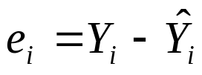

Diagnostics
Diagnostics for the response variable are usually carried out indirectly through an examination of the residuals.
The residual e_{i} is the difference between the observed value Y_{i} and the fitted value Y_{i}(hat).
The residual may be regarded as the observed error, as opposed to the unknown true error ε_{i} in the model. They are used as estimates of the true errors.

Slide 8
Diagnostics
For our regression model, we assume a linear relation between X and Y and that the error terms ε_{i} are independent normal random variables, with mean 0 and constant variance σ².
If the model is appropriate for the data, the observed residuals e_{i} should reflect these properties.
Whether a linear function is appropriate for our data can be assessed from plotting the residuals against the predictor variable X, or equivalently, from plotting the residuals against the fitted values Y_{i}(hat).
Nonlinearity can also be assessed from a scatterplot, but this plot is not always as effective as a residual plot.

Slide 9
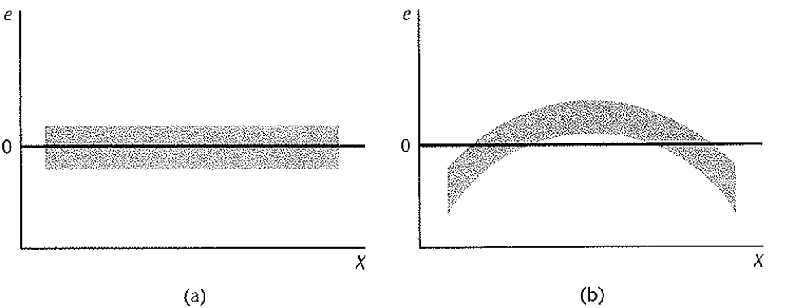
Diagnostics
When a linear regression model is appropriate, the residuals plotted against X – or the residuals plotted against the fitted values Y_{i}(hat) - will show a random scatter about 0.
When linearity holds, the residuals will fall within a horizontal band centered around 0, displaying no systematic tendencies to be positive or negative (plot a). If the residuals vary in a systematic fashion, this indicates a departure from linearity (plot b).

Slide 10
Diagnostics
A residual plot against the predictor variable, or equivalently a residual plot against the fitted values, can also be used to examine whether the variance of the error terms is constant.
If the assumption is correct, we again see a random scatter around 0 with no systematic pattern.
Quite commonly, however, residual values may increase or decrease as the size of the predictor variable increases.
This is a result of the error variance increasing or decreasing as the size of the predictor variable increases. The residuals are centered around 0 and the larger the variance, the larger the absolute value of the residuals will tend to be.

Slide 11
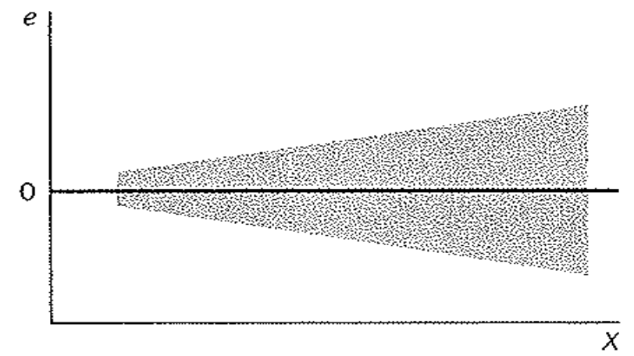
Diagnostics
If the error variance increases, the residual cloud becomes "funnel shaped" with the larger end toward larger X values. If the error variance decreases, then the funnel shape has a larger end toward smaller X values.
Typically, the residuals will have increasing variance as the fitted values of Y increases, which may correspond to larger or smaller values of X.

Slide 12
Diagnostics
Outliers are extreme observations. Residual outliers can be identified from residual plots against X or the fitted values.
Plotting the standardized residuals can also be helpful for distinguishing outlying observations, since it is easy to distinguish outliers that are many standard deviations away from 0.
A rule of thumb is that standardized residuals with an absolute value of four or more are considered outliers.

Slide 13
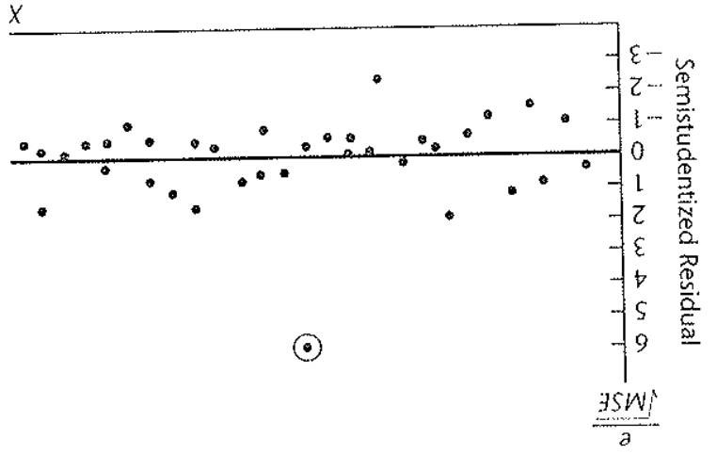
Diagnostics
The residual plot below shows standardized residuals and contains one outlier, which is circled.
The residual is 6 standard deviations away from the mean 0.

Slide 14
Diagnostics
Outliers can create great difficulty and often they are deleted.
Under the least squares method, a fitted line may be pulled disproportionally toward an outlying observation because this minimizes the sum of the squared deviations.
This can cause a misleading fit, especially if the observation was a result of a mistake.
On the other hand, outliers can convey important information, such as when an outlier occurs as a result of an interaction with another predictor variable not in the model.

Slide 15
Diagnostics
A safe rule is to discard an outlier only if there is direct evidence that it represents an error in recording, a miscalculation, a malfunctioning of equipment, or a similar type of circumstance.
SAS diagnostics_e

